Slide 1
ConCase
Submitted by:
Nitesh Kumar Gouda

Slide 2
The Challenging Market
Paint point with respect to partnerships through long and arduous process of:
At a Micro Level
The potential demand of members and managers and their willingness to pay for these services, evaluating also the long-term trajectories in terms of sustainability
Design
The technical feasibility and start-up costs
Delivery
Installation
Process
40.8%
Negative impact on membership and contract renewals
Reach to Tier 2 and Tier 3 cities is limited, but with the rise of startups culture there is a potential market in these cities with growth and culture.
The risk of shifting the coworking concept, due to the loss of dynamism and involvement in sharing the space in favor of a more static and utilitarian use of it
67.2%
Drop in the number of new membership enquiries of space
As Per The CBRE Report From Last Year
Landlords, are also starting to move away from traditional lease structures and leaning towards partnership agreements with flex office providers, where they share profits, losses, and capital expenditures.
Co-working Is No Longer Niche
That’s partly because co-working is no longer reserved for independent contractors and freelancers. As of the first quarter of 2021, more than half of the industry membership base was made up of big enterprises.

Slide 3
Improvement Plan
Optimizing the Hybrid Model for Company & WeShare
Hybrid Collaboration, using videoconferencing systems and a 180-degree camera that stitch a room together for a more seamless experience
Target mostly small and medium-size teams and offer amenities like wellness rooms, private conference rooms, daily breakfast, coffee, and more
Hybrid Model
Productivity (Individual and Team)
Checkpoints
Ability to access talent
Cost of Real Estate
Company leaders and most employees spend majority, but not all, of their time in 1-2 principal offices
Multiple proportionate-size offices with leadership and employees dispersed among all offices
Dispersed across small-footprint “microhubs” located in various geographies
Periodic In-Person collaboration and connectivity
Plan for 5000 Sq. Ft.
Partially remote work, large HQ
First 1,500
We’ve designed a café very much in line with other coffeehouses
Other 3,500
Space is single-and two-person offices and private coworking booths
Partially remote work, multiple hubs
Single Point of Contact for
Multiple Microhubs
Design
Ordering
Installation
Partially work with Flex Space
Foresworn Leases In Exchange For Revenue Shares With Building Owners
Instead of paying rent, it gives landlords a share of its revenue for about 80 percent of its portfolio. That arrangement allowed it to expand into new locations during the pandemic. It also let it minimize losses, since bringing in less revenue meant it had to pay out less as well.
*Hybrid Spaces includes temporarily (e.g., Monthly) rented space used in select cities for periodic gathering and collaboration

Slide 4

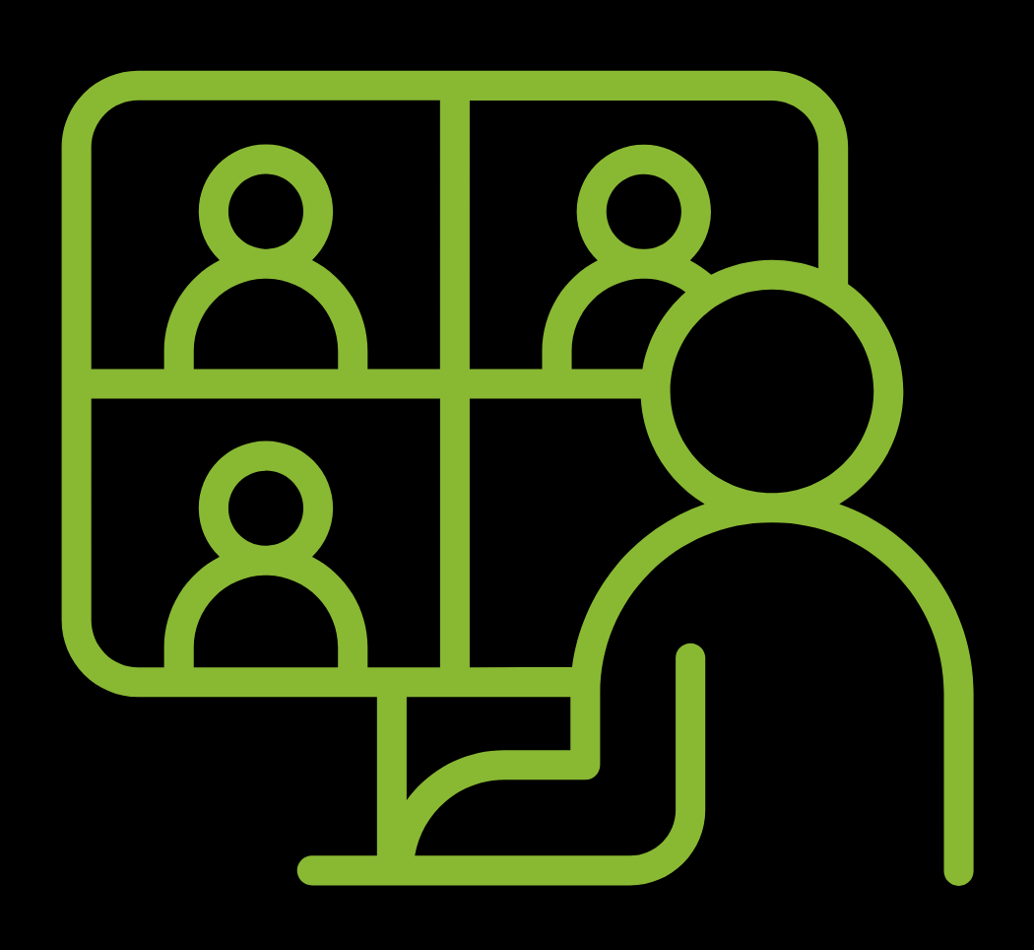
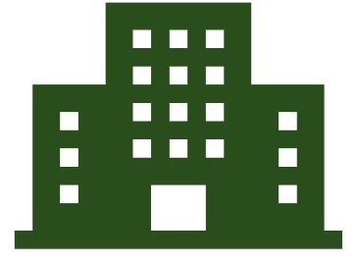
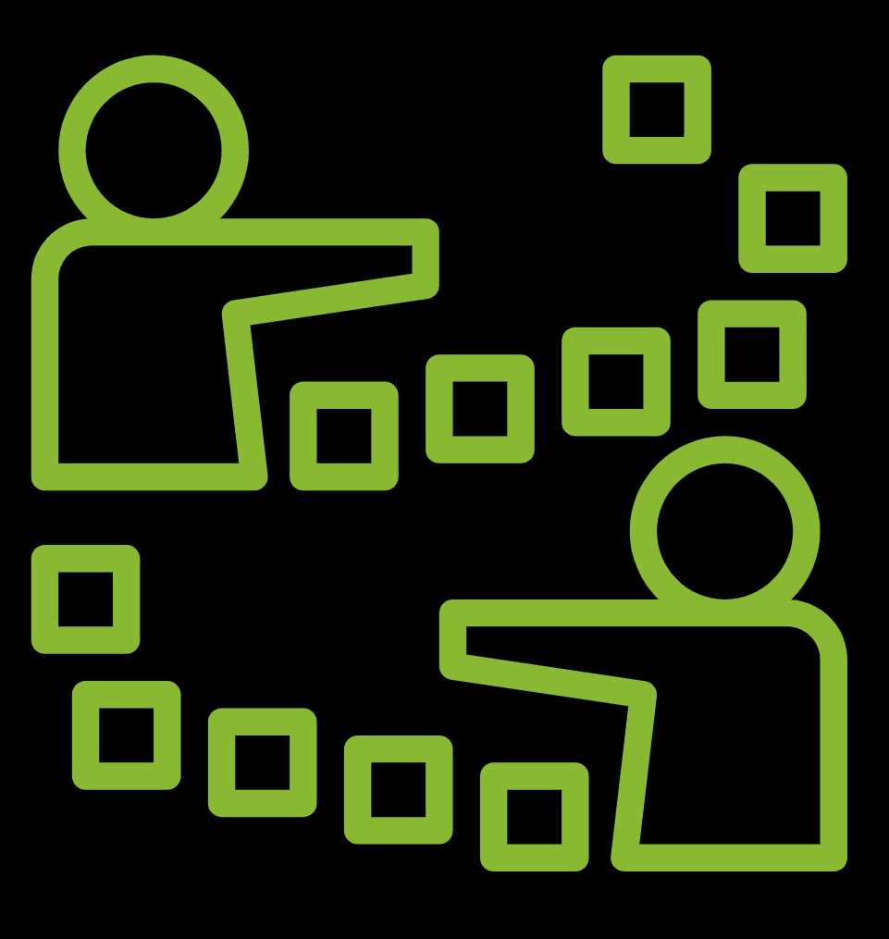

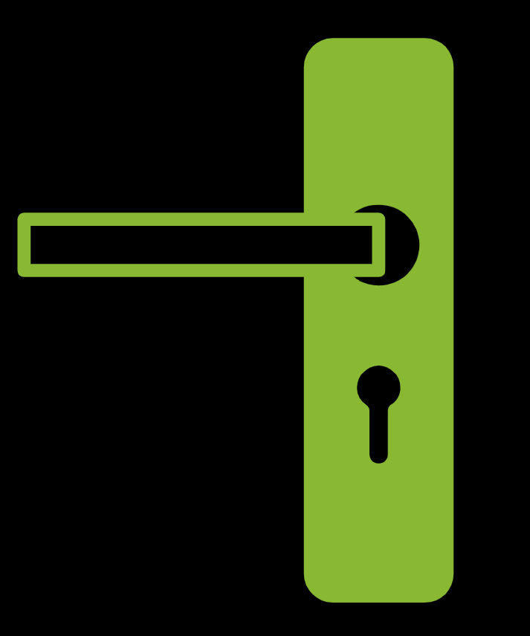
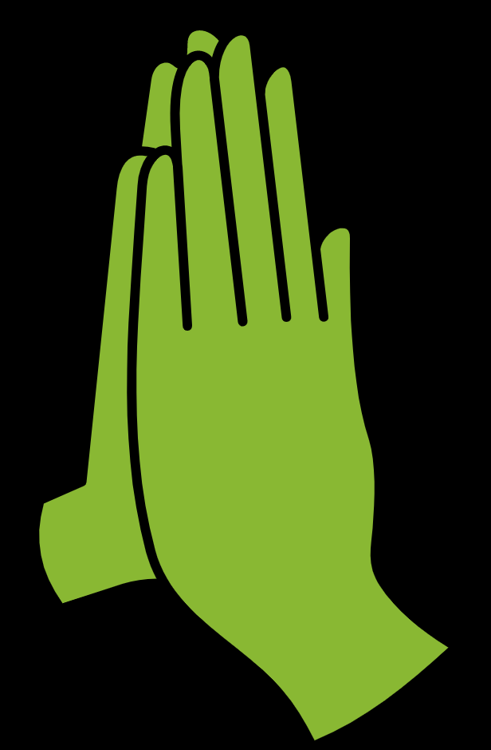
HUB-AND-SPOKE MODEL
Speciﬁc Preventive Measures
Women Grown Business
Provide professional services, networking opportunities and fundraising support to women growing their own small businesses
Satellite Office
Satellite Office
A toolkit for Flexible Ofﬁce Operators”
Why?
Social Workplaces proposes to train coworking staff on hygiene practices
Satellite Office
Central Office
Satellite Office
While people of all genders make up its membership
Maximum rise in Women led SMEs during pandemic
Satellite Office
Satellite Office
Implement Cleaning Protocols And New Hygiene
Compared to traditional office spaces, more companies may adopt a hybrid working model
Local Initiatives
Clean things like door handles, taps, light switches, etc.
Pick-up In Demand For
Additional services by food delivery companies
Diversifying the portfolio by expanding the network to public and/or private spaces
Facilities to use for storage and other purposes
Efficient Flexible Workspaces
High-Quality
Namaste instead of handshake habit
Well-located
Properly Furnished And Commercial

Slide 5


Thank you!

